Slide 1



Music Genre Classifier
Submitted by:
Arin Kulshreshtha(RA2211026030009)
Aniket Routray(RA2211026030018
Baladitya(RA2211026030019)
Ashutosh Jaiswal(RA2211026030042)

Slide 2
Abstract
The music genre classifier project aims to automate the identification of music genres by leveraging machine learning techniques. This project involves extracting audio features such as Mel-Frequency Cepstral Coefficients (MFCCs), chroma features, and spectrograms to capture essential patterns in the music. Various machine learning models, including Support Vector Machines (SVMs), K-Nearest Neighbors (KNNs), and deep learning architectures like Convolutional Neural Networks (CNNs), are explored to classify audio tracks into predefined genres.
This project has practical applications in music streaming services, audio library management, and personalized recommendations. Future enhancements include real-time classification and expanding the model to identify subgenres for finer categorization, contributing to improved music discovery and organization.

Slide 3
Introduction
Music is the art of arranging sound and noise together to create harmony, melody, rhythm, and expressive content. It is organized so that humans and sometimes other living organisms can express their current emotions with it. We all have our own playlist, which we listen to while traveling, studying, dancing, etc. So here today, we will learn how can we implement the task of genre classification using Machine Learning in Python.
Music plays a significant role in human culture, with genres acting as a way to categorize and identify different musical styles. With the increasing volume of music being produced and streamed globally, there is a growing need for automated classification of music genres. Traditionally, music genres were manually labeled by experts, but this process can be subjective, time-consuming, and prone to inconsistencies. Machine Learning (ML) offers a powerful solution by automating genre classification with high efficiency and accuracy.
A music genre classifier using machine learning is a system that analyzes the features of audio tracks and predicts their genre, such as pop, jazz, rock, or classical. By leveraging techniques from signal processing and machine learning algorithms, the classifier extracts meaningful features from audio data and identifies patterns unique to each genre.

Slide 4
Existing Problems
1
Data Quality and Quantity
High-quality labelled datasets are crucial for training effective models. Many available datasets might be imbalanced (e.g., fewer samples for some genres) or contain noisy data (e.g., mislabelled tracks).
2
Feature Extraction
Choosing the right features is essential. Common approaches use audio signals, but different features (like spectrograms, MFCCs, or raw waveforms) can lead to varying results. The choice of features can significantly affect the classifier's performance.
3
Genre Overlap
Many genres have overlapping characteristics, making it difficult to distinguish between them. For instance, songs in the pop and rock genres may share similar instrumentation and structure.
4
Subjectivity of Genres
Genre classification can be subjective. What one person considers jazz might overlap with another's definition of blues or soul. This variability can lead to inconsistent labelling in training datasets.
5
Contextual Factors
The cultural and contextual background of music can affect its genre
classification. Songs from different regions or eras may defy typical genre boundaries.

Slide 5
The proposed solution aims to develop a robust machine learning-based classifier that identifies the genre of music tracks by analyzing their acoustic characteristics. This system will leverage audio preprocessing techniques to extract features such as Mel-Frequency Cepstral Coefficients (MFCCs), chroma features, and spectrograms, which provide insights into timbre, rhythm, and tonal content. A Convolutional Neural Network (CNN) will serve as the core architecture, given its ability to detect spatial patterns in spectrogram images. For capturing sequential dependencies in music, Recurrent Neural Networks (RNNs) or LSTMs can be integrated into the model. These networks will help handle the temporal structure inherent in musical compositions. Hybrid models combining CNNs and RNNs are proposed for improved performance. To address challenges such as genre overlap and dataset imbalance, data augmentation (e.g., pitch shifting or time stretching) will be applied. The classifier will be trained on publicly available datasets like GTZAN to ensure reliable performance. Metrics such as accuracy, F1-score, and confusion matrix will be used for evaluation. The final system is intended to work in real-world applications, such as music streaming platforms and audio library management, facilitating better personalized recommendations and efficient music categorization.
Proposed Solution

Slide 6
Technologies Used
Data Collection and Storage
This phase involves sourcing, organizing, and storing the audio data required for training the classifier.
Datasets:
GTZAN Dataset : A popular dataset with 10 music genres.
FMA (Free Music Archive) : Open-licensed music tracks.
Million Song Dataset (MSD) : Large-scale metadata and audio features.
File Handling Libraries:
OS Module (Python): For local file management.
PyDub: For audio format conversion and manipulation.
FFmpeg: Command-line tool for handling and converting multimedia files.
Data Preprocessing
Data preprocessing ensures that the audio files are ready for analysis by converting formats, resampling, and normalizing data.
NumPy: For handling numerical data and arrays.
SciPy: For signal processing operations.

Slide 7
Phase
Technologies
Data Collection
GTZAN,, Google Drive
LibROSA, PyDub, FFmpeg, NumPy, SciPy
Preprocessing
Feature Extraction
Machine Learning Models Evaluation
Model Storage
Project Management
LibROSA, OpenSMILE
Scikit-Learn
Scikit-Learn, Matplotlib, Seaborn
Pickle, Joblib
Google colab, GitHub

Slide 8
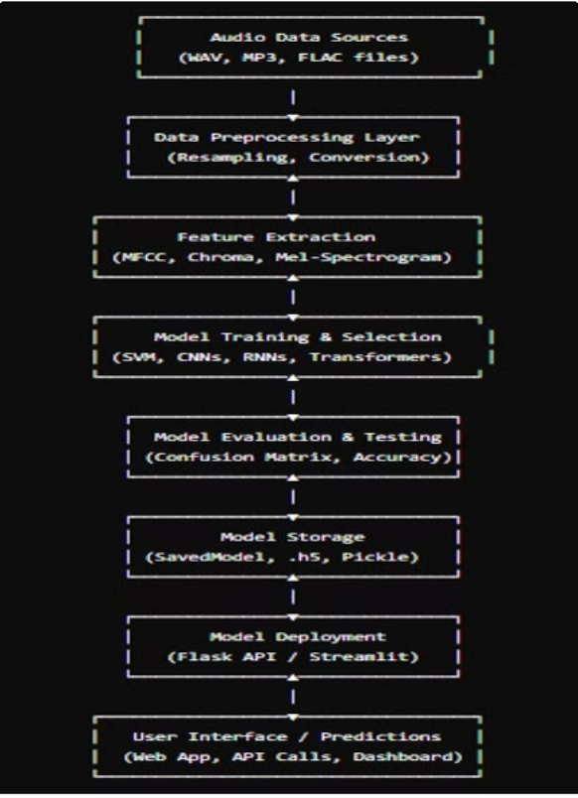

Architectural Diagram

Slide 9
Methodology
Data Collection and Preparation
Data is the foundation of any machine learning project. This step ensures that the raw audio data is collected, organized, and preprocessed for further analysis.
·Data Sources:
·Datasets like GTZAN and Million Song Dataset provide labeled audio files.
·Data Augmentation (Optional):
·Audiomentations Library: Adds variations by applying noise, pitch shift, or time stretch to increase the diversity of the dataset.
·Handling Imbalanced Data:
·Oversampling rare genres using SMOTE (Synthetic Minority Oversampling Technique).
·Alternatively, undersampling the majority classes.
2. Data Preprocessing
Preprocessing ensures that the audio data is uniform and ready for feature extraction.
·Standardization of Audio Files:
·Format Conversion: Convert audio files into WAV or MP3 using FFmpeg.
·Resampling: Resample all audio files to a common sample rate (e.g., 22.05 kHz).
·Mono Conversion: Convert stereo tracks to mono to reduce complexity.
·Silence Removal and Trimming:
·Tools like LibROSA help detect and remove silent sections in the audio.

Slide 10
Feature Extraction
This step extracts relevant features from the audio signal, which serve as inputs to the machine learning models.
Time-Domain Features:
· Zero-Crossing Rate (ZCR): Measures how frequently the signal changes from positive to negative.
Frequency-Domain Features:
MFCCs (Mel-Frequency Cepstral Coefficients): Capture the timbre of the music, making them crucial for genre classification.
Chroma Features: Analyze harmonic content by mapping pitches to a 12-note chromatic scale.
Time-Frequency Representations:
Mel Spectrograms: Visualize frequency vs. time, suitable for CNNs.
Model Selection and Training
Traditional Machine Learning Models:
These models work well on smaller datasets with pre-extracted features like MFCCs.
Support Vector Machines (SVM): Effective for high-dimensional data.
Random Forests / Decision Trees: Useful for interpretable models.

Slide 11
The rise of machine learning in music genre classification
Increased Data Availability
The rise of digital music platforms and streaming services led to a massive influx of labeled music data, providing ample training material for machine learning algorithms.
Advancements in Machine Learning Algorithms
Significant advancements in machine learning algorithms, particularly deep learning, enabled the development of more sophisticated models capable of capturing complex patterns in musical data.
Improved Feature Extraction Techniques
Developments in audio processing techniques, such as the extraction of spectrograms and Mel-frequency cepstral coefficients (MFCCs), provided richer and more informative features for machine learning models.

Slide 12
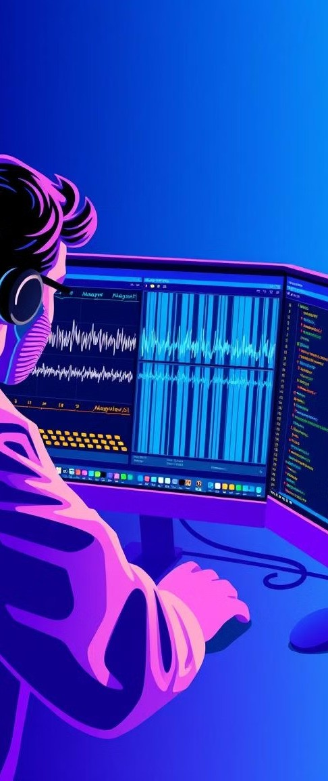
Feature engineering for music genre classification
Feature | Description
Tempo | The speed of the music, measured in beats per minute (BPM)
Rhythm | The pattern of notes and rests, including the timing and duration of musical events
Timbre | The unique sonic qualities of instruments and voices, influenced by factors like the shape and material of instruments or the vocal characteristics of singers
Melody | The sequence of musical notes, often characterized by its pitch and contour
Harmonic Content | The chords and progressions used in the music, defining the overall tonal structure
Lyrical Content | The words and meaning of the lyrics, which can provide clues about the genre and theme of the song

Slide 13
Result

Slide 14
Conclusion
In conclusion, the music genre classifier project successfully demonstrates how machine
learning models can automate genre identification with a high degree of accuracy. From feature extraction to model deployment, each phase of the project plays a crucial role in building a robust, scalable system. While challenges like overlapping genres and subjectivity remain, the combination of traditional machine learning and deep learning techniques provides a solid foundation for future development.
This project not only showcases the potential of ML in music analytics but also opens up new avenues for exploration, such as real-time classification, personalized recommendations, and trend analysis. With continuous advancements in machine learning and access to larger datasets, the music genre classifier holds great promise for transforming the way we experience and interact with music.

Slide 15
References
Below are key references for building a music genre classifier:
https://www.geeksforgeeks.org/music-genre-classifier-using-machine-learning/
https://github.com/ABSounds/MusicGenreClassification
https://ar5iv.labs.arxiv.org/html/1804.01146
https://medium.com/@baraq/classifying-song-genres-with-machine-learning-37258250504a
https://www.kaggle.com/datasets/purumalgi/music-genre-classification

